Slide 1


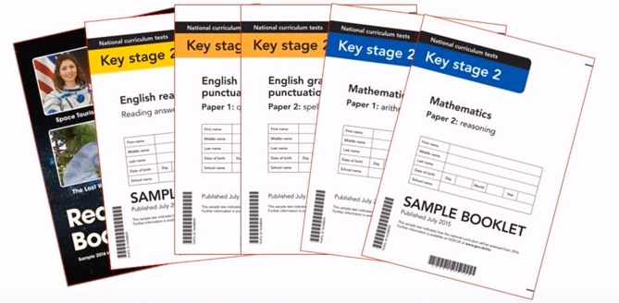
KS2 Parents’ SATs Information Evening
Friendship, Forgiveness, Courage and Perseverance

Slide 2
Why are SATs important?
A chance for the child to demonstrate everything that they have learnt during their time at primary school
Allows parents to understand where their child sits in terms of comparing nationally with other children of a similar age
Results from KS2 are used by secondary schools to determine which ‘ability set’ your child will be in and will also determine their predicted GCSE grades
Friendship, Forgiveness, Courage and Perseverance

Slide 3
SATs: What parents need to know…
At the end of Year 6, (during May) children sit tests in Reading, Mathematics and Spelling, Punctuation and Grammar.
These tests are both set and marked externally.
Friendship, Forgiveness, Courage and Perseverance

Slide 4
The tests are compulsory for all Year 6 children in the country and must be administered on the date shown on the timetable below.
Date test to be administered | Test
Monday 10th May, 2027 | English grammar, punctuation and spelling Paper 1 : questions (45 minutes) English grammar, punctuation and spelling Paper 2: spellings (20 minutes)
Tuesday, 11th May, 2027 | English reading (60 minutes)
Wednesday, 12th May, 2027 | Mathematics Paper 1: arithmetic (30 minutes) Mathematics Paper 2: reasoning (40 minutes)
Thursday, 13th May, 2027 | Mathematics Paper 3: reasoning (40 minutes)
Results will be published in the middle of July.
Friendship, Forgiveness, Courage and Perseverance

Slide 5
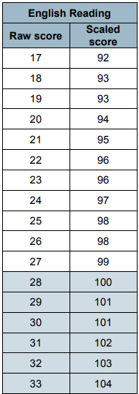
SATs Scores Explained…
Each child’s raw score in the test (28/50 in the reading test, for example) is turned into a scaled score, based on making comparisons with the other children across the country who took the same test.
The scaled scores are centred around 100. That means that:
A score of 100 means the child is working ‘at the expected standard’ for a Year 6 child. 80 is the lowest possible score and 120 is the highest.
A scaled score of 99 or less means they haven’t reached the government’s ‘expected standard’.
A scaled score of 110 must be achieved in order to be classed as ‘working at greater depth’.
Friendship, Forgiveness, Courage and Perseverance

Slide 6
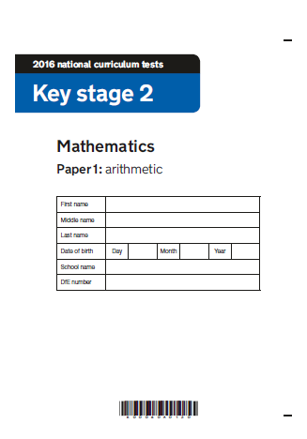
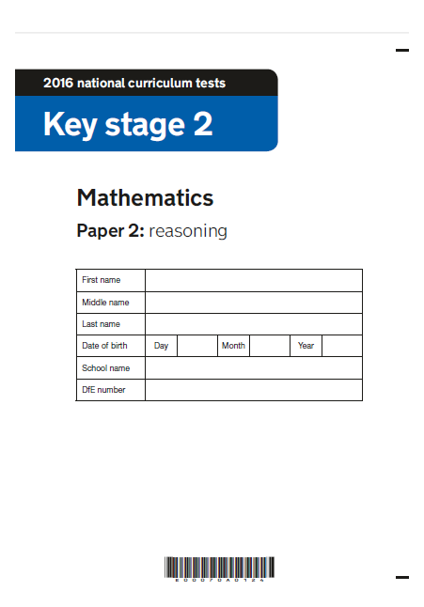
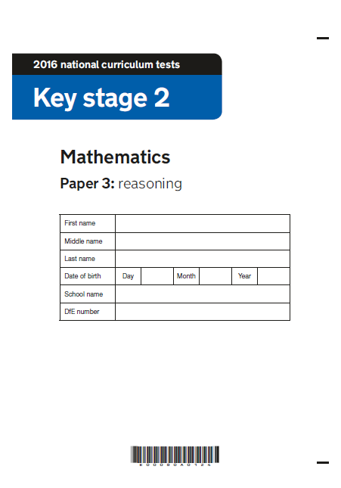
Maths – 3 papers
110 marks available in total
Not all children will be able to access all of the papers – there is no longer a separate ‘harder’ paper!
To achieve expected standard – approx. 60 marks
To achieve greater depth – approx. 95 marks
Friendship, Forgiveness, Courage and Perseverance

Slide 7
Paper 1: arithmetic
Four operations (+ - / x)
Fractions
Decimals
Percentages
Fixed response questions – children have to give the correct answer to calculations.
36 questions – 30 minutes.
There are 40 marks available for this test!
Friendship, Forgiveness, Courage and Perseverance

Slide 8
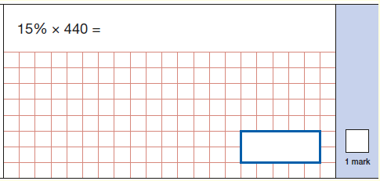
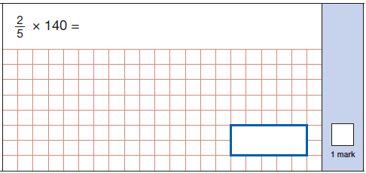
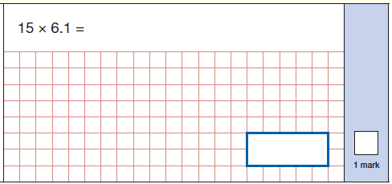
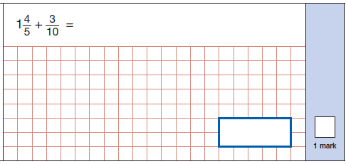
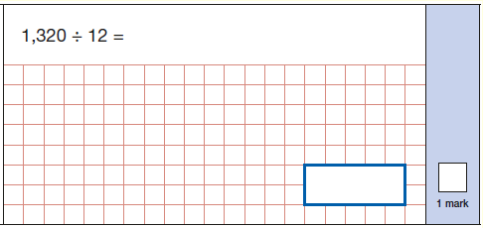
Friendship, Forgiveness, Courage and Perseverance

Slide 9
Paper 2 & 3: reasoning
Papers 2 and 3 will involve a number of question types, including:
Multiple choice
True or false
Constrained questions, e.g. giving the answer to a calculation, drawing a shape or completing a table or chart
Less constrained questions, where children will have to explain their approach for solving a problem.
20 questions on each paper – 40 minutes per paper.
There are 35 marks available for each of these tests! A total of 70 marks.
Friendship, Forgiveness, Courage and Perseverance

Slide 10
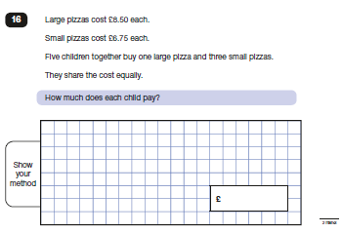
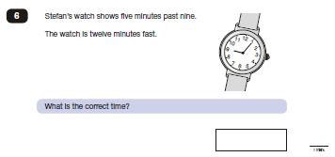
Paper 2 & 3: reasoning
Friendship, Forgiveness, Courage and Perseverance

Slide 11
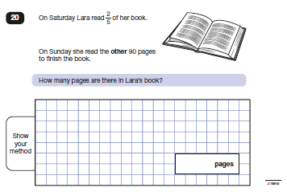
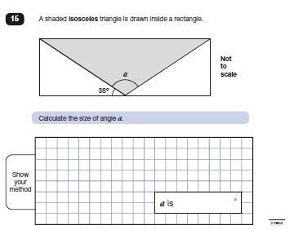
Paper 2 & 3: reasoning
Friendship, Forgiveness, Courage and Perseverance

Slide 12
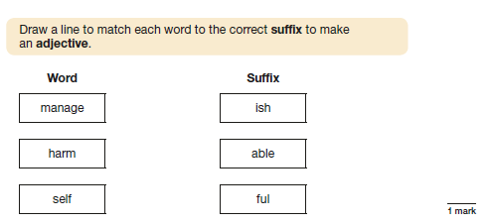
SPaG Paper 1 – 50 marks
(40 questions, 45 minutes to complete)
Friendship, Forgiveness, Courage and Perseverance

Slide 13
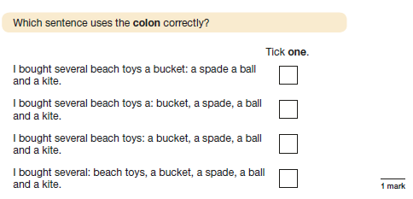
SPaG
Friendship, Forgiveness, Courage and Perseverance

Slide 14
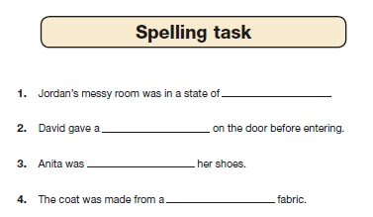
SPaG Paper 2 – Spellings
20 questions and 20 marks available
No time limit for this – usually takes about 15 minutes.
Children need to score 38 out of the possible 70 marks (SPaG and spelling tests) to reach expected standard.
Friendship, Forgiveness, Courage and Perseverance

Slide 15

Reading – 1 Paper
1 hour and 50 marks available.
Consists of three separate texts with questions for each.
Tests a variety of reading skills
Questions vary from multiple choice, short answers to longer answers.
Answers can be worth 1 mark, 2 marks or three marks.
To achieve expected standard – 28/50 marks
To achieve greater depth – 40/50marks
Friendship, Forgiveness, Courage and Perseverance

Slide 16
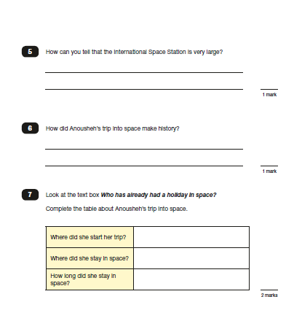
Reading Test
Friendship, Forgiveness, Courage and Perseverance

Slide 17
The Reading Comprehension key skills:
Retrieving information
Making inferences
Word Meaning
Friendship, Forgiveness, Courage and Perseverance

Slide 18
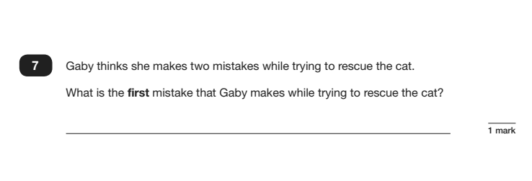
Retrieving information:
Friendship, Forgiveness, Courage and Perseverance

Slide 19
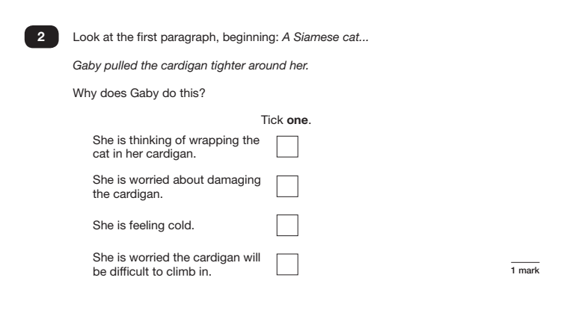
Making Inferences (reading between the lines):
Friendship, Forgiveness, Courage and Perseverance

Slide 20
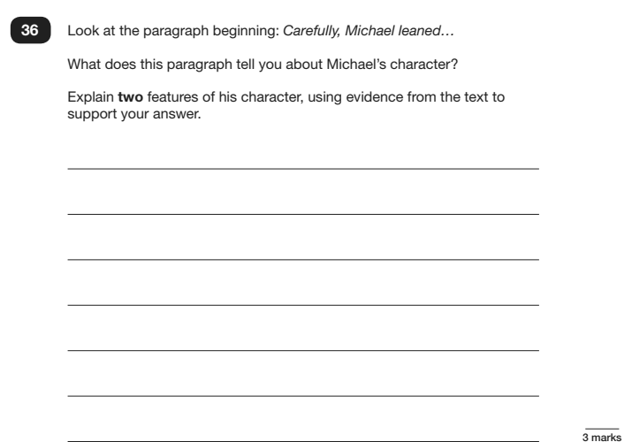
Making Inferences (reading between the lines):
Friendship, Forgiveness, Courage and Perseverance

Slide 21
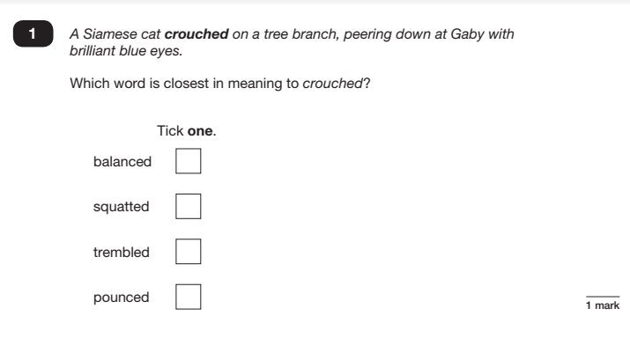
Word Meaning (A Life Skill):
Friendship, Forgiveness, Courage and Perseverance

Slide 22
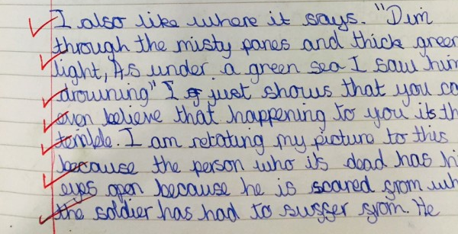
Writing
Writing is assessed internally by your child’s teacher and then moderated by the Local Authority.
These have to be submitted by the end of June.
For your child to achieve ARE (Age Related Expectation), they must use cursive handwriting. This is a government expectation.
Friendship, Forgiveness, Courage and Perseverance

Slide 23
How we prepare the children…
Half-termly assessments
Intervention groups
Before & after school clubs (& lunchtime)
Provide revision materials (and nearer the time) a revision timetable
Focussed one-to-one support
Friendship, Forgiveness, Courage and Perseverance

Slide 24
How you can help your children…
Read with your child and check their understanding
Help your child learn times tables and encourage
them to use TT Rockstars
Ensure your children complete homework
Promote attendance to after school/holiday clubs
Promote good attendance
Friendship, Forgiveness, Courage and Perseverance

Slide 25


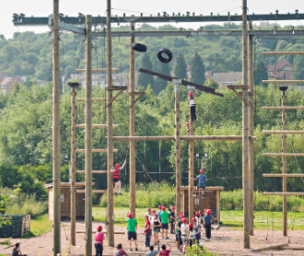

How we will be rewarding your child’s efforts…
Friendship, Forgiveness, Courage and Perseverance

Slide 26

Friendship, Forgiveness, Courage and Perseverance

