Slide 1

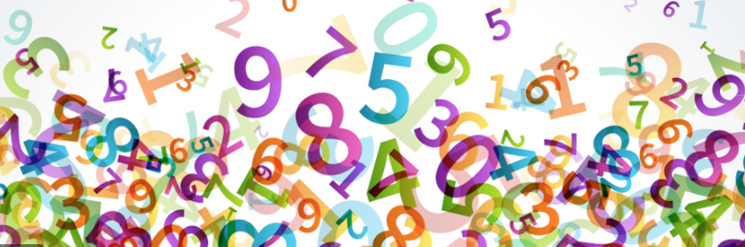
Year 4
Multiplication tables check

Slide 2
Why are times tables important?
Times tables are the essential foundation of understanding for many different areas of maths, including division, fractions, area and algebra.
Children who do not have a secure understanding of times tables find it extremely difficult to access more complex areas of maths.

Slide 3
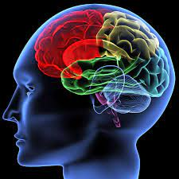
It is important to build fluency with times tables
If children have not committed their times tables to their long-term memory, they will be unable to apply these skills to other areas of maths.
To successfully apply these skills, times tables need to be automatic, freeing up working memory to process and solve more complex problems.
Don’t practise until they get it right - practise until they can’t get it wrong!

Slide 4
The 2023 MTC – why do we need it?
The purpose of the MTC is to determine whether pupils can recall their times tables fluently, which is essential for future success in mathematics. It will help schools to identify pupils who have not yet mastered their times tables, so that additional support can be provided.
Just as phonics screening checks helps children who are learning to read, the multiplication tables check will help teachers identify those pupils who require extra support. This will ensure that all pupils leave primary school knowing their times tables by heart and able to then start secondary school with a secure grasp of fundamental arithmetic as a foundation for mathematics.

Slide 5
How can you help minimise anxiety?
Tests in themselves don’t cause anxiety – it is the perceived cost of not doing well which causes it.
The more familiar children are with something the less anxiety there will be.
Talk about the importance of knowing times table facts and how much easier they will find other areas of maths with this knowledge.
A consistent message from school and home.

Slide 6
When the multiplication tables check will be carried out?
There will be 3-week window in June for the administration of the check (5th June – 16th June).
There is no set day to administer the check.
Children are not expected to take the check at the same time.
All eligible* Year 4 pupils in England will be required to take the check.
*If a pupil is not entered for the check, the school should inform the pupil’s parents.

Slide 7
How the multiplication tables check is carried out?
The check will be fully digital and take place on screen.
Children will be able to use laptops, desktops and tablets.
Answers will be entered using a keyboard or by pressing digits using a mouse or touchscreen using an on-screen number pad.
This is no different to what the children are used to doing in school. We have been practising the MTC since September.

Slide 8
How the multiplication tables check is carried out?
• Under standard administration the multiplication check will take less than 5 minutes per pupil.
• Children will get 6 seconds from the time the question appears to input their answer.
• There will be 25 questions with a 3 second pause in-between questions.

Slide 9
Specific arrangements for multiplication tables check
Children with additional needs, who have similar provision in their day-to-day learning at school, may be allotted specific arrangements, including:
• Colour contrast
• Font size adjustment
• ‘Next’ button (alternative to 3-second pause)
• Removing on-screen number pad
• An adult to input answers
• Question reader
• Audible time alert

Slide 10
The questions
• Each pupil will be randomly assigned a set of questions.
• There will be repeated questions across different checks each year, but no more than 30% of questions will be repeated in any two checks.
• Children will only face multiplication statements in the check (not related division facts).
• Pupils will not see their individual results when they complete the check.

Slide 11
How the school teaches times tables
so pupils learn instant recall
We also…
Practise times tables every morning when the children first come into school.
Sing different times tables (loopy loops) at the start of every maths lesson.
Use the ipads for TT rockstars several times a week.
Once a week we have been using the MTC practise site https://www.timestables.co.uk/multiplication-tables-check.
Teaching times tables facts first:
• Counting and looking for patterns
• Repeated addition
• Multiplication is commutative
• Multiplication is the inverse of division
• Number families use of different representations
• Concrete manipulatives such as counters or multilink cubes
• Pictorial representations such as arrays

Slide 12
How can I support my child in preparing for their
multiplication tables check?
Firstly, a positive attitude goes a long way – so as much encouragement and support as possible!
Some further tips:
• Make times tables fun
• Climb stairs counting in multiples
• Play verbal times tables games
• Listen to and learn times tables songs
• Play online maths games ( www.mulitplication.com)
• Talk directly to your child’s class teacher if you have any worries (try not to worry your child)
• Encourage your child to talk to you, their teacher, or another adult they trust, if they express persisting anxieties about the check. Remember that a small amount of anxiety is normal and not harmful.

Slide 13

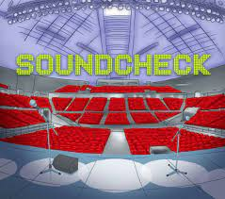
How can I support my child in preparing for their
multiplication tables check?
Soundcheck - When you play Soundcheck, you get 20 questions each with a 5-second time limit. The questions are multiplication only and evenly weighted in terms of difficulty each time you play.
https://www.timestables.co.uk/multiplication-tables-check/

Slide 14
Remember this about the multiplication tables check
The check will focus on what they know about times tables.
It won’t reflect their understanding of wider mathematical topics.
The check is only 5 minutes long.
For most children, the check will last for a maximum of 5 minutes. When they have finished, they will not need to repeat the check, regardless of their final score.

Slide 15

Any questions?

