Slide 1
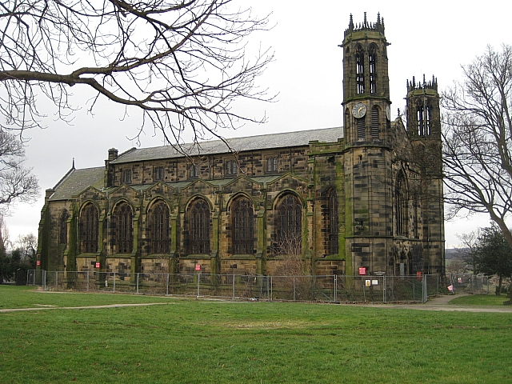

Welcome to the
English - Writing
LIT
Session
Friendship, Forgiveness, Courage, Perseverance, Honesty and Acceptance

Slide 2
Our Writing Vision
At Stanley St Peter’s Primary School, we want our children to be equipped and inspired to produce high-quality writing that is: engaging and imaginative; has a purpose; and commands the reader’s attention. Through our English curriculum, we endeavour to provide our children with the opportunity to develop their skills and knowledge that will enable them to communicate effectively and creatively through spoken and written language and equip them with the skills to become lifelong learners.
Friendship, Forgiveness, Courage, Perseverance, Honesty and Acceptance

Slide 3
We want children to:
Use exciting and inspiring materials to support and challenge them.
Be confident, capable and enthusiastic writers who will develop a genuine love of writing.
Write independently for a range of purposes.
Be proud of their writing in all areas of the curriculum.
Reflect on their own and others’ writing.
Develop the stamina and skills to write at length, with accurate spelling and punctuation.
Expand their vocabulary and apply spelling rules in their writing.
Write fluently and legibly at speed.
Have the opportunity to experience a wide range of whole texts and extracts from a range of fiction, non-fiction and poetry genre.
Have the opportunity to meet published authors/journalists and to learn and be inspired by their experiences..
Friendship, Forgiveness, Courage, Perseverance, Honesty and Acceptance

Slide 4
How do we achieve this?
Access to a range of resources such as dictionaries, thesauruses, IPads and individual whiteboards to support their work.
Modelling of handwriting and opportunities provided to hone their handwriting skills throughout the week.
Develop a range of extra activities that will promote English within the school including Curriculum Talent Awards and author visits.
Teaching of age appropriate spelling, punctuation and grammar embedded within our teaching of the genre being studied.
Throughout the school year, encourage our whole school community to get involved in a range of events to celebrate our love of English, with an intention of creating lifelong lovers of reading and writing.
Teaching spellings regularly with a focus on oracy.
Use of high quality texts.
Writing will be linked to the projects being studied in history and geography.
Teachers will model high standards of writing within lessons using visualizers to aid the demonstration of quality work.
Writing experts will be celebrated weekly.
Critical thinking lessons will be used to introduce each unit of writing.
Friendship, Forgiveness, Courage, Perseverance, Honesty and Acceptance

Slide 5
Lesson Timetable
9:05am – 9:15am
Handwriting
Every minute of every day counts!
We recently adjusted our daily timetable to allow sufficient, dedicated time for handwriting. (Cursive handwriting is an ARE in Year 6.)
Friendship, Forgiveness, Courage, Perseverance, Honesty and Acceptance

Slide 6
Lesson Timetable
9:15am – 9:45am
Year 1 – Writing: Key Skills
Question Sentence (question mark) Y1 – sentence demarcation (. ! ?) Y1– beginning to punctuate sentences using a capital letter and a full stop, question mark or exclamation mark Develop an understanding of a broad range of questions stems that exist. Begin with why, when, what, who and where. Why do you think he ran away? When are we going to the theatre? Single Word Sentence (full stop & exclamation mark) Can use basic descriptive language: colour, size, simple emotion. He was a tall, sensible man.
Friendship, Forgiveness, Courage, Perseverance, Honesty and Acceptance

Slide 7
Lesson Timetable
Monday and Friday - 9:15am – 9:45am
Wednesday – 1:15pm-1:30pm
Spellings
Within these lessons we focus on a specific spelling rule (practising ten spellings per week), as well exploring the vocabulary in context. Children are taught to develop their oracy skills and have the opportunity to rehearse the given spellings multiple times We introduce the spelling rule and investigate how it affects grammar and punctuation; for example, does it change the tense of the root word? Has the word class changed? Following on from what the children were taught during RWI, we continue to use ‘tick and fix’ to highlight any mistakes and allow the children to correct their work immediately. We then test the children on a Friday.
Friendship, Forgiveness, Courage, Perseverance, Honesty and Acceptance

Slide 8
Lesson Timetable
11:15am – 12:15pm - English/RWI Lessons
1:15pm – 1:30pm - ERIC Time/Speedy Sounds (Wednesday = Spellings)
3:10pm – 3:25pm - Class Novel Time
Friendship, Forgiveness, Courage, Perseverance, Honesty and Acceptance

Slide 9
Teaching Writing in English Lessons
Friendship, Forgiveness, Courage, Perseverance, Honesty and Acceptance

Slide 10
What we need to consider when teaching English to specific year groups:
Genre coverage
Reviewing/embedding prior learning
Language structures (pronouns, modal verbs, active/passive voice, etc.)
Sentence construction (adverbials of time, linking paragraphs, subordinate clauses, etc.)
Vocabulary (appropriate prefixes, suffixes, word choice, etc.)
Punctuation
Friendship, Forgiveness, Courage, Perseverance, Honesty and Acceptance

Slide 11

The End Goal…
End of KS2 writing moderation.
It is important to understand what the end goal is!
Last year, our writing data was 13% above the national average, with 87% of Year 6 children achieving the age related expectation or above!
The children and staff throughout school work extremely hard to ensure the children unlock their potential.
Friendship, Forgiveness, Courage, Perseverance, Honesty and Acceptance

Slide 12
English Lessons
11:15am – 12:15pm
Friendship, Forgiveness, Courage, Perseverance, Honesty and Acceptance

Slide 13
LO: use informal language features
SPaG Starter
On a whiteboard, copy the main clause from the sentence below.
Due to the vicious waves, the ship (which was carrying over 400 slaves) rocked heavily upon the sea.
Success Criteria
Bronze – Use of first person, past tense and correctly punctuated contractions.
Silver – Include a variety of informal writing features.
Gold – Use figurative descriptions informally.
Friendship, Forgiveness, Courage, Perseverance, Honesty and Acceptance

Slide 14
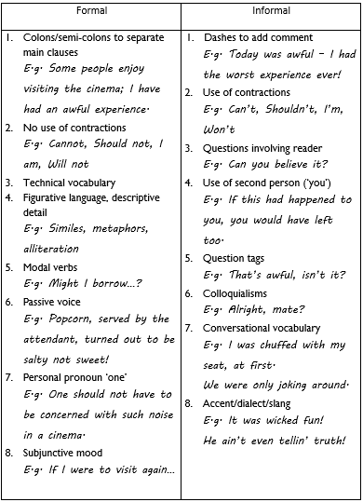
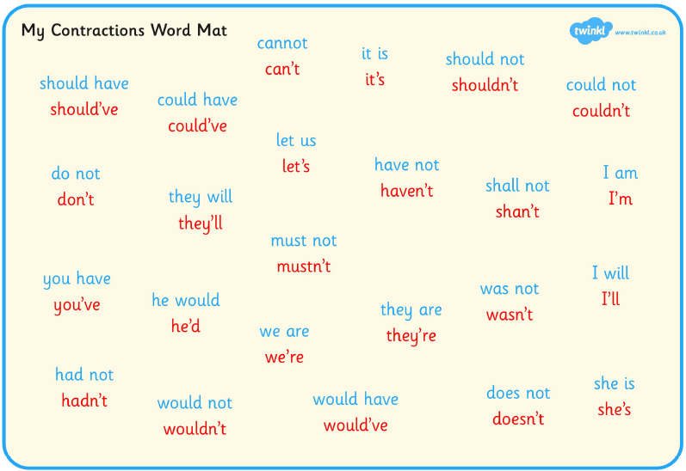
Resources Available
Friendship, Forgiveness, Courage, Perseverance, Honesty and Acceptance

Slide 15
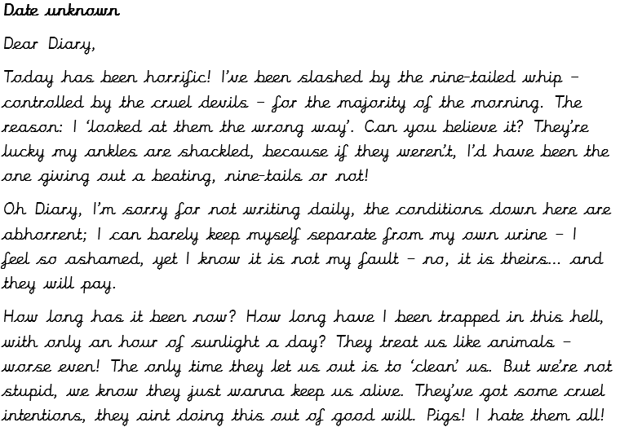
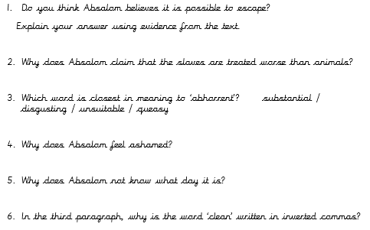
Example of Excellence
Friendship, Forgiveness, Courage, Perseverance, Honesty and Acceptance

Slide 16
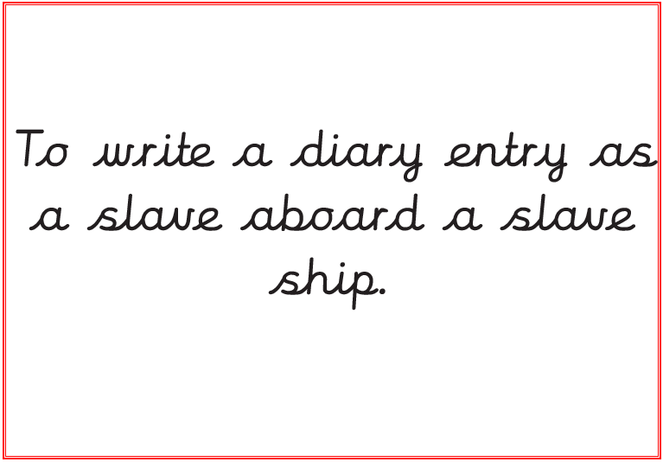
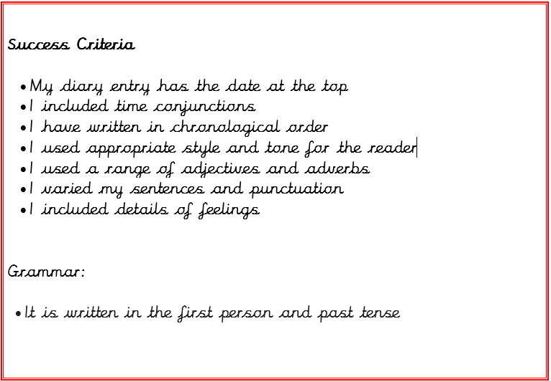
Key Purpose and Success Criteria
Linked to project lessons and/or the class novel or science.
Friendship, Forgiveness, Courage, Perseverance, Honesty and Acceptance

Slide 17
Outcome Piece
At the end of each unit, the children have the opportunity to plan and write their own piece of writing based on the key purpose they have been studying.
This is a piece of work that the children are very proud of.
Friendship, Forgiveness, Courage, Perseverance, Honesty and Acceptance

Slide 18
What’s New for the Children?
ERIC Time - Everybody Reading in Class
Spellings lessons adapted to incorporate grammar focuses and develop oracy
Theme days such as National Poetry Day, Music and Grammar Shows
Author visits
Critical thinking lessons
‘Examples of Excellence’
Friendship, Forgiveness, Courage, Perseverance, Honesty and Acceptance

Slide 19
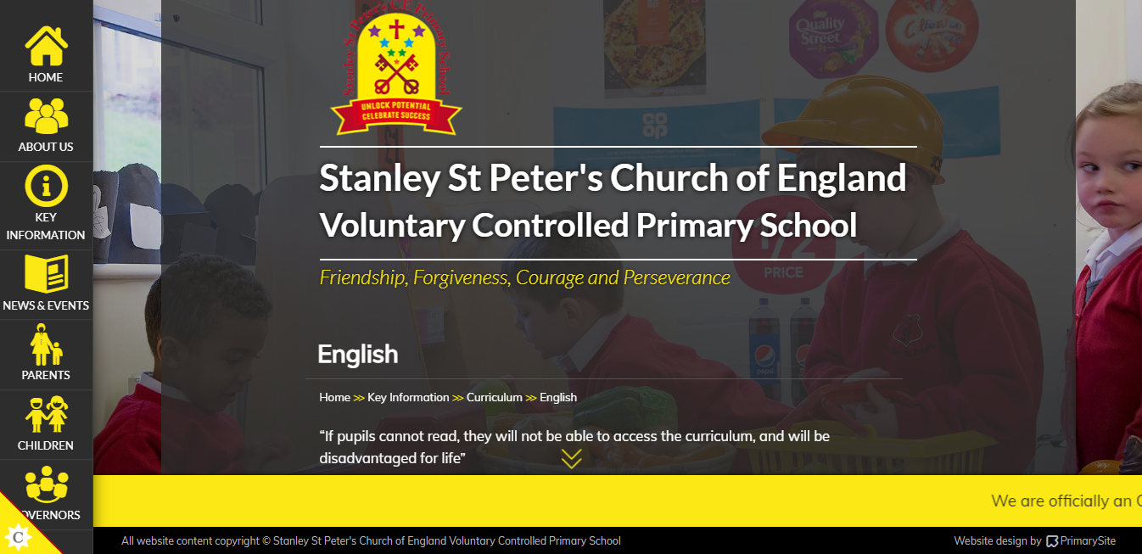
https://www.stanleystpeters.co.uk/english/
Friendship, Forgiveness, Courage, Perseverance, Honesty and Acceptance

