Slide 1


Welcome to the
Phonics
LIT
Session
Friendship, Forgiveness, Courage, Perseverance, Honesty and Acceptance

Slide 2
Our Phonics Vision
At Stanley St Peter’s our main aim is to ‘Unlock Potential and Celebrate Success’ and we believe that phonics is a fundamental skill that will allow us to achieve that aim. Our consistent and rigorous approach to teaching early reading enables children to master the key skills that research suggests is important early on. To do this, we follow the Read Write Inc. programme; this sets out a sequence of lessons that teaches children to read accurately and fluently with good comprehension. They also learn to form each letter, spell correctly and compose their ideas step-by-step.
Friendship, Forgiveness, Courage, Perseverance, Honesty and Acceptance

Slide 3
What do we hope to achieve for our children?
At Stanley St Peter’s our vision is that our children read fluently and with comprehension. They are given the opportunity to expand their vocabulary and apply spelling rules in their writing. Our children will be confident, capable and enthusiastic readers and writers who will develop a genuine love of reading and writing. They will be equipped to write independently for a range of purposes. We will provide the opportunity for our children to build the stamina and skills to write at length, with accurate spelling and punctuation. Our children will have the opportunity to experience a wide range of whole texts and extracts from a range of fiction, non-fiction and poetry genre.
Friendship, Forgiveness, Courage, Perseverance, Honesty and Acceptance

Slide 4
How will we achieve this?
Children will:
Learn 44 sounds and the corresponding letter/letter groups using simple prompts.
Learn to read words using sound blending (Fred talk) e.g. c-a-t = cat, sh-o-p = shop.
Read ‘red words’ these are words that have less common spelling patterns.
Read lively stories featuring words they have learnt to sound out.
Show that they comprehend the stories by answering 'Find It' and 'Prove It'.
Learn to write the letter/letter groups which represent the 44 sounds.
Learn to write words by saying the sounds and graphemes (Fred fingers).
Learn to write simple then more complex sentences.
Compose stories based on story strips.
Compose a range of texts using discussion prompts.
Friendship, Forgiveness, Courage, Perseverance, Honesty and Acceptance

Slide 5
Lesson Timetable - EYFS
9.05am – 9.35am – RWI
1.00pm – 1.15pm – Fred games/ Pinny time.
3.15pm- 3.30pm – Fred games/Pinny time.
Friendship, Forgiveness, Courage, Perseverance, Honesty and Acceptance

Slide 6
Lesson Timetable – KS1/KS2
11.15am- 12.15pm – RWI
1.15pm – 1.30pm (Year 1)– Fred games/ Pinny time.
.
Friendship, Forgiveness, Courage, Perseverance, Honesty and Acceptance

Slide 7
Teaching Phonics
Friendship, Forgiveness, Courage, Perseverance, Honesty and Acceptance

Slide 8
What a Phonics lesson like looks.
A phonics lesson is split into 3 parts:
A speed sounds session
A reading task.
A writing task.
Friendship, Forgiveness, Courage, Perseverance, Honesty and Acceptance

Slide 9
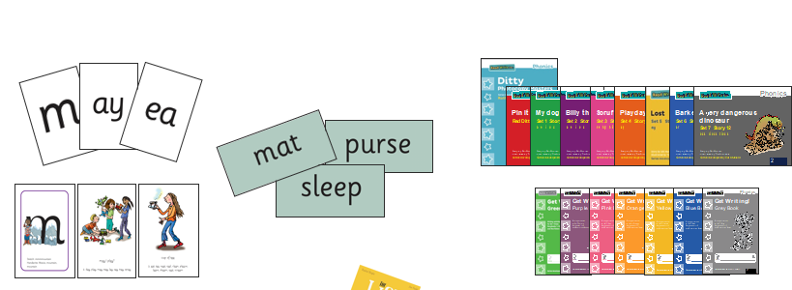
Read, Write Inc
What Read Write Inc. does is simple - we teach children to read and write sounds – children practise reading and spelling words containing these sounds, and then we give children decodable books, containing sounds and words they can read.
Friendship, Forgiveness, Courage, Perseverance, Honesty and Acceptance

Slide 10
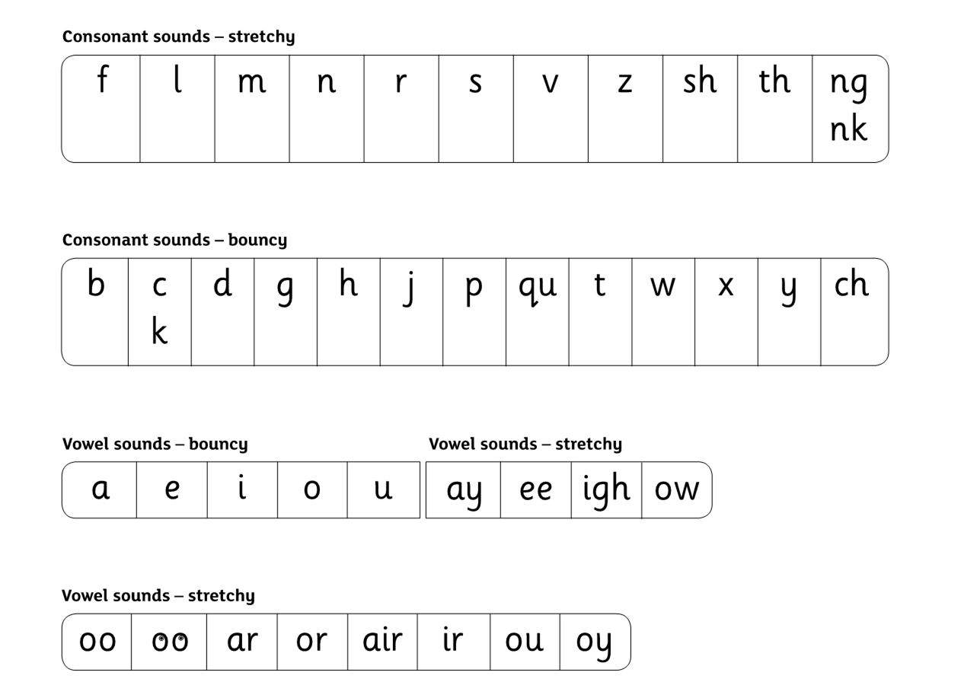
Speed Sounds Set 1 and 2
Friendship, Forgiveness, Courage, Perseverance, Honesty and Acceptance

Slide 11
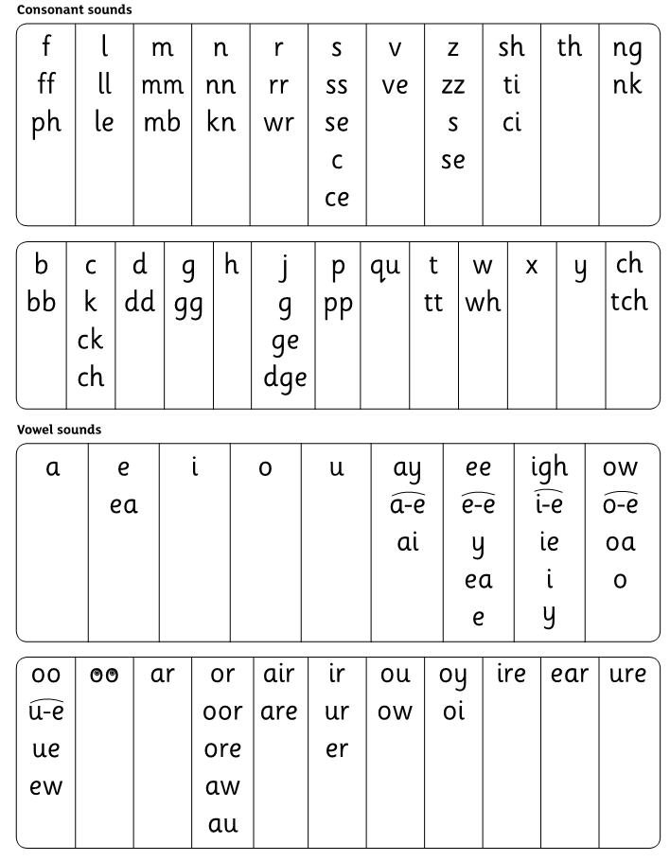
Speed Sounds Set 3
Friendship, Forgiveness, Courage, Perseverance, Honesty and Acceptance

Slide 12
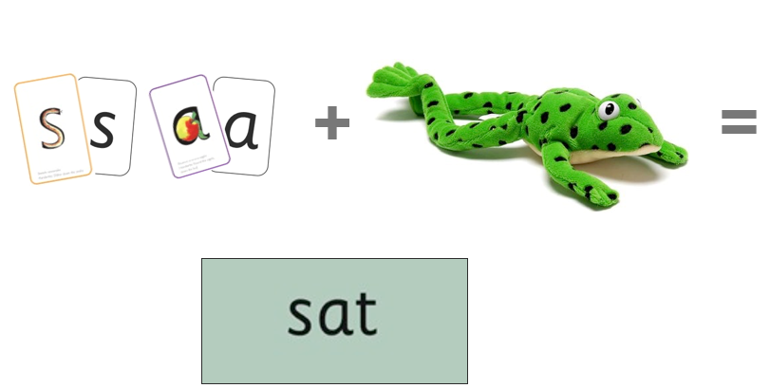
Sounds + blending = word reading
Alongside teaching children sounds, we teach them to blend sounds to read words e.g. s-a-t, sat.
Once children can read sounds speedily, like this, (show how speedily this needs to be) and understand Fred (m-a-t...mat) (click), they can decode words.
Friendship, Forgiveness, Courage, Perseverance, Honesty and Acceptance

Slide 13

Teach spelling using Fred Fingers
We use Fred Fingers to help children sound out words so that they can spell them more easily.
It means they do not have to memorise lists of spelling words.
It is a tool so that they will be able to spell any word phonetically (even if they cannot spell them correctly, they can make their meaning clear).
Friendship, Forgiveness, Courage, Perseverance, Honesty and Acceptance

Slide 14
Read, Write Inc
They read each Storybook three times at school and again with you at home.
With each reading, children’s fluency increases and they can focus more on what the story is about.
Children also learn to spell the words they have been reading and develop their ideas into sentences so that they can write about the Storybooks they have read.
Alongside this, we read stories to children: stories they cannot yet read for themselves
Friendship, Forgiveness, Courage, Perseverance, Honesty and Acceptance

Slide 15
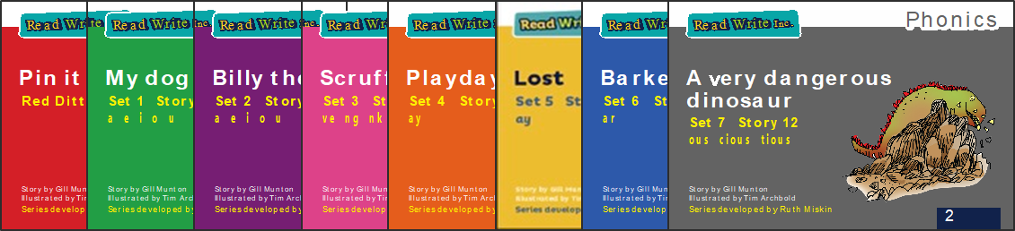
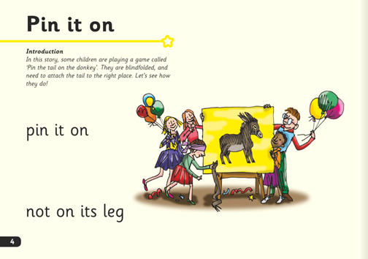
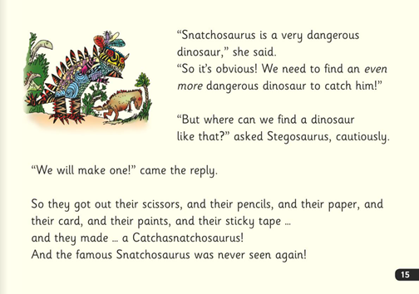
Three Reads
In our school, children read Read, Write Inc. Storybooks that match the sounds that they can read.
They read each Read Write Inc. Storybook three times in class with their partner.
Re-reading the same book helps children to become confident readers. Each time they re-read, they build their fluency/speed and comprehension.
Friendship, Forgiveness, Courage, Perseverance, Honesty and Acceptance

Slide 16


‘Special Friends, Fred Talk’
Children should be able to read all of the words in the Storybook.
If they hesitate, remind them to read the word by saying, ‘Special Friends, Fred Talk, read the word’.
For example, this means they spot the ‘sh’, then Fred Talk, then blend to read the word e.g. sh, sh-i-p, ship.
Friendship, Forgiveness, Courage, Perseverance, Honesty and Acceptance

Slide 17


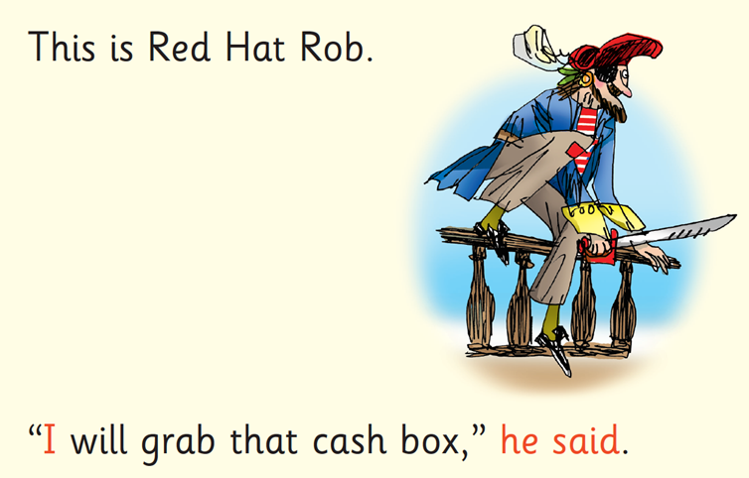
Red words
Some words are ‘tricky’ because they contain letters that don’t match the sounds the child have been taught.
For example, ‘said’ has ‘ai’ making an ‘e’ sound.
We teach these common exception words as Red words.
Friendship, Forgiveness, Courage, Perseverance, Honesty and Acceptance

Slide 18

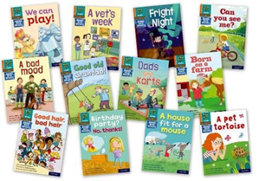
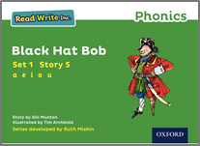
What books will children bring home?
In your child’s book bag, they will bring home:
the Storybook they have just read in class to practice reading what they can already read.
The children enjoy re-reading stories they know well. Their fluency improves on every reading.
- a Book Bag Book that links to the story they have read in class. This will be less familiar but contain only sounds and words that your child already knows.
We make sure that every book that goes into your child’s book bag is a well-loved book – one they know already and want to read again and again.
Friendship, Forgiveness, Courage, Perseverance, Honesty and Acceptance

Slide 19
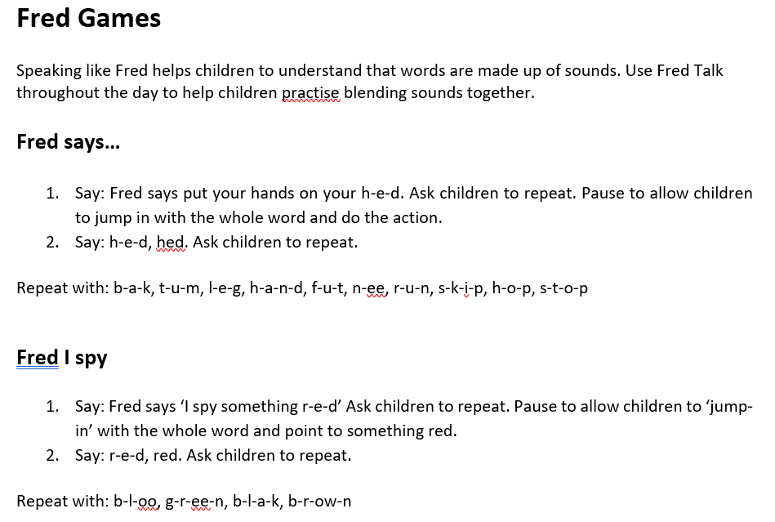
Fred Games!
Friendship, Forgiveness, Courage, Perseverance, Honesty and Acceptance

Slide 20
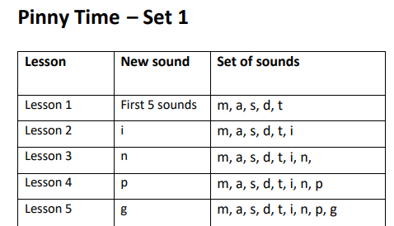
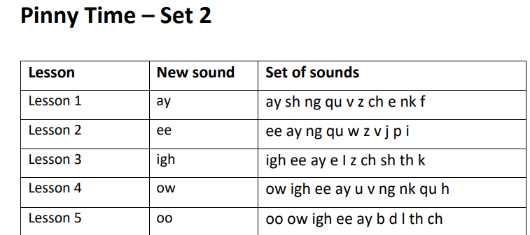
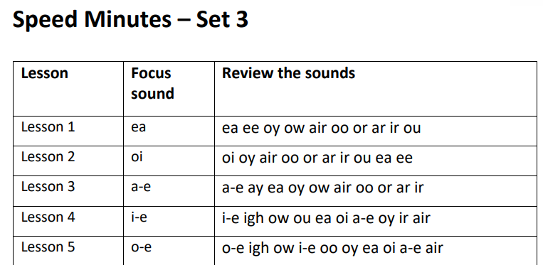
Pinny Time!
Friendship, Forgiveness, Courage, Perseverance, Honesty and Acceptance

Slide 21
Progress groups
Group children by phonic stages.
Teach to the group’s challenge level.
Re-assess all children every half term (although ongoing day to day assessment may identify a child as needing to be moved on more quickly).
Friendship, Forgiveness, Courage, Perseverance, Honesty and Acceptance

Slide 22
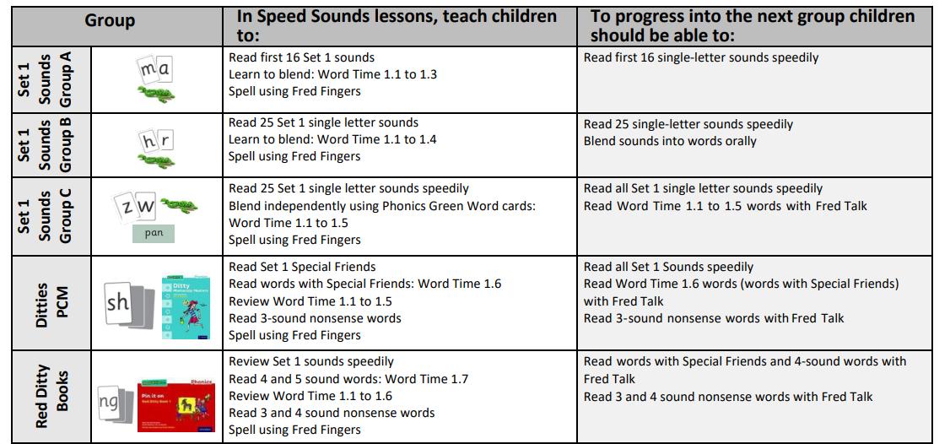
What to teach when
Friendship, Forgiveness, Courage, Perseverance, Honesty and Acceptance

Slide 23
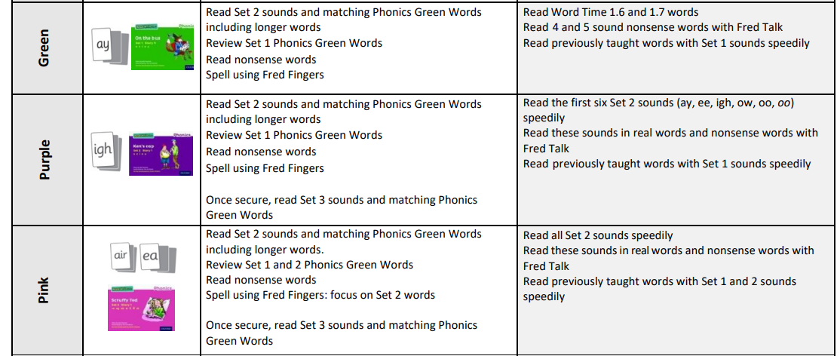
What to teach when
Friendship, Forgiveness, Courage, Perseverance, Honesty and Acceptance

Slide 24
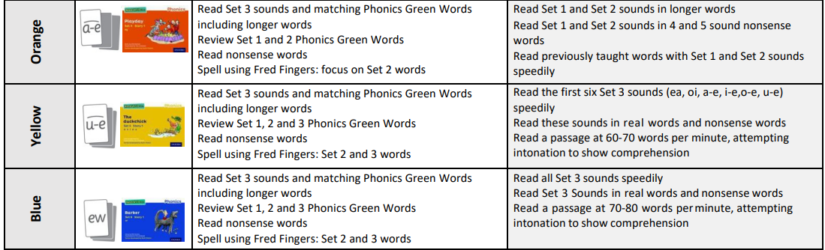
What to teach when
Friendship, Forgiveness, Courage, Perseverance, Honesty and Acceptance

Slide 25
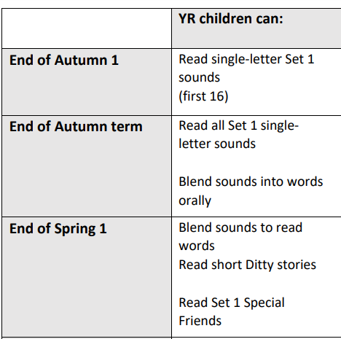
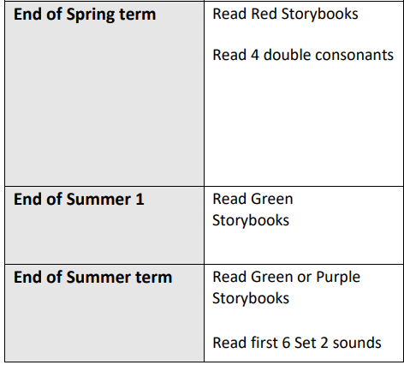
The end goal - EYFS
Friendship, Forgiveness, Courage, Perseverance, Honesty and Acceptance

Slide 26
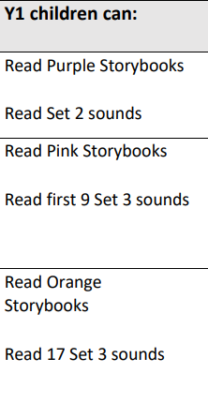
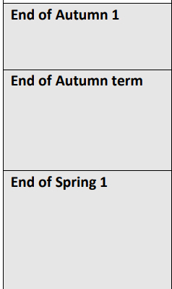
The end goal – Y1
Friendship, Forgiveness, Courage, Perseverance, Honesty and Acceptance

Slide 27
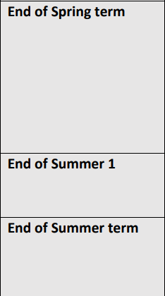
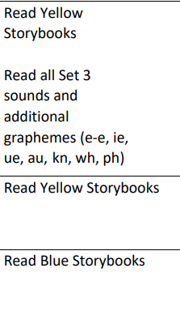
The end goal – Y1
Friendship, Forgiveness, Courage, Perseverance, Honesty and Acceptance

Slide 28
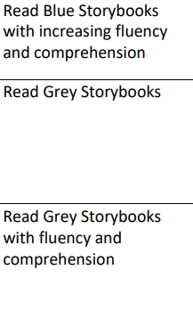
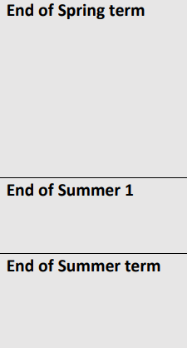
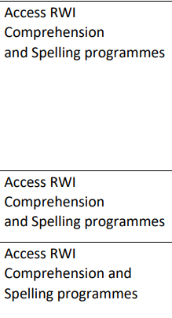
The end goal – Y2
Friendship, Forgiveness, Courage, Perseverance, Honesty and Acceptance

Slide 29
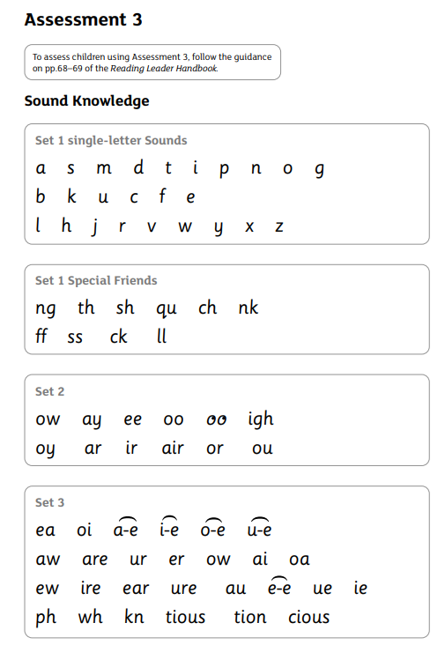
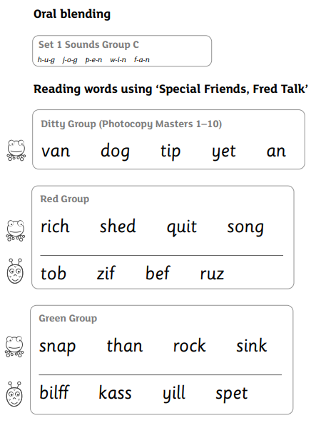
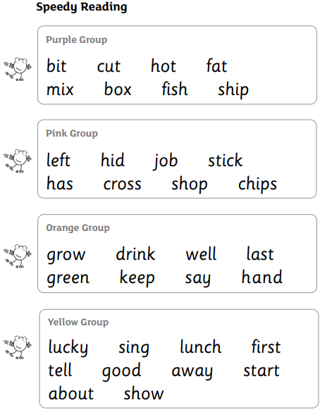
Assessment
Friendship, Forgiveness, Courage, Perseverance, Honesty and Acceptance

Slide 30
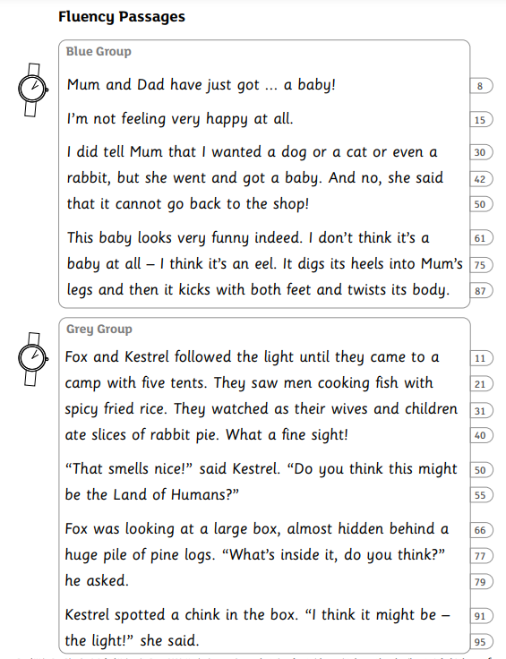
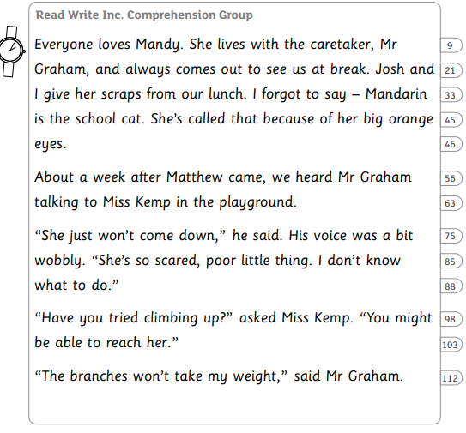
Assessment
Friendship, Forgiveness, Courage, Perseverance, Honesty and Acceptance

Slide 31
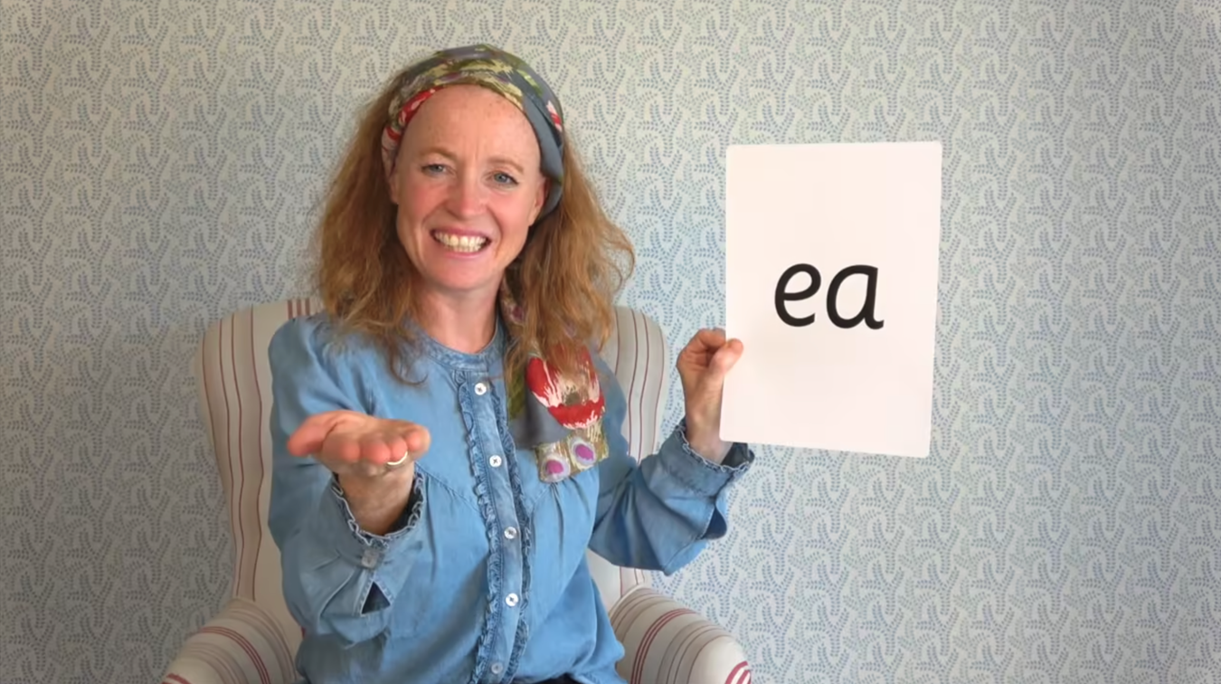
Virtual Classroom Films
Home film links to lessons that match the sounds and words your child has been learning in school are available on the school website.
There are lessons to support children at every stage of the Read Write Inc. Phonics programme.
Your child uses the Virtual Classroom in school.
Children are familiar with the VC teachers – and interact with them as they would their own teacher.
Watch these films with your child to help them to practise reading the sounds and words until they can read them speedily.
Simply click the link and watch on a tablet or other device.
Let’s have a look at one of these films on the Virtual Classroom. Play a Set 2 or 3 at home film from the virtual classroom.
Friendship, Forgiveness, Courage, Perseverance, Honesty and Acceptance

Slide 32
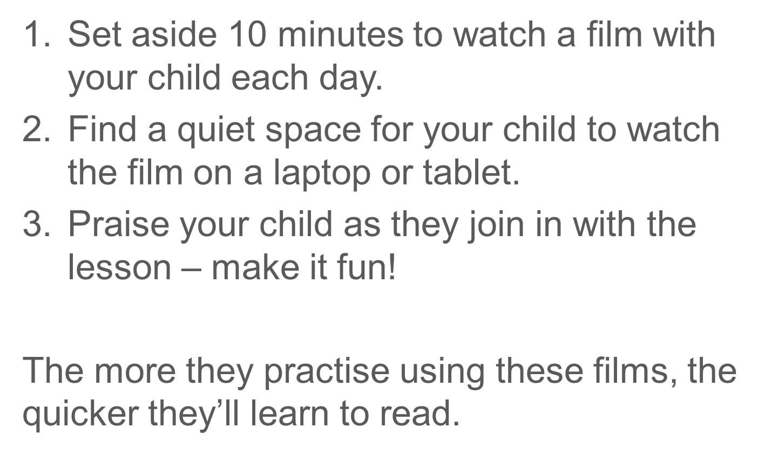
How can I use the virtual classroom?
Friendship, Forgiveness, Courage, Perseverance, Honesty and Acceptance

Slide 33
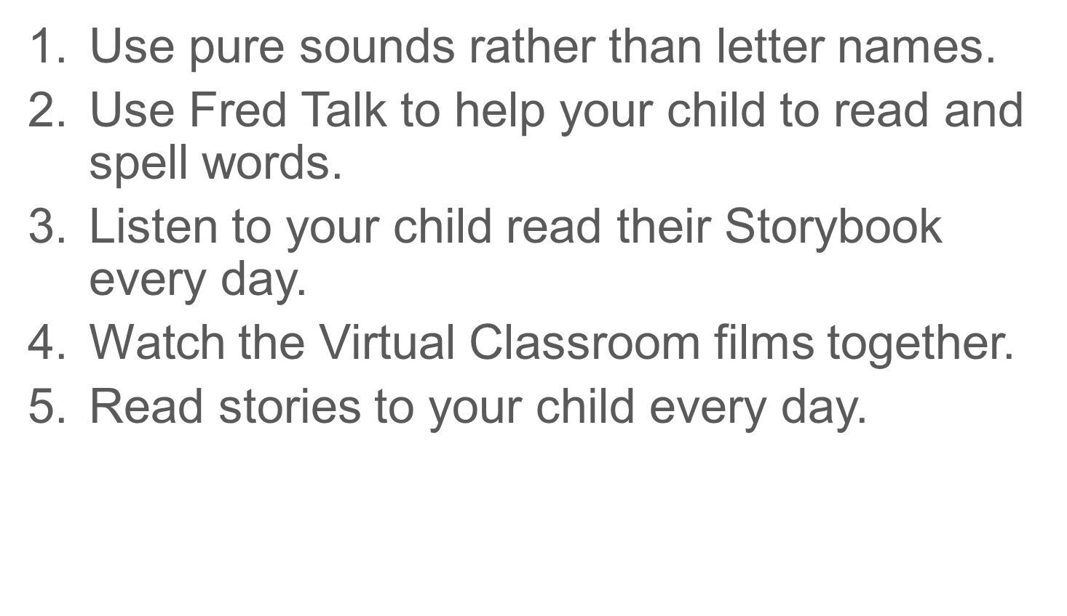
What can you do?
Friendship, Forgiveness, Courage, Perseverance, Honesty and Acceptance

Slide 34
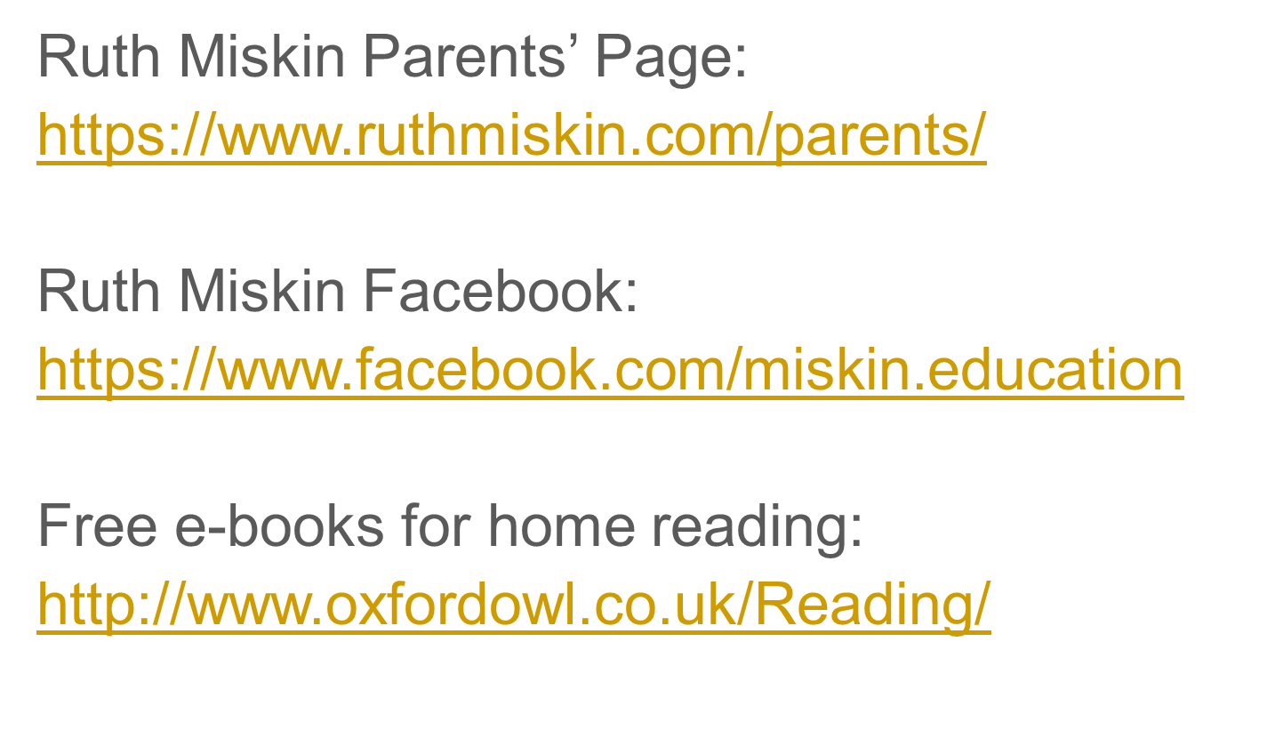
Read, Write Inc resources
Friendship, Forgiveness, Courage, Perseverance, Honesty and Acceptance

Slide 35
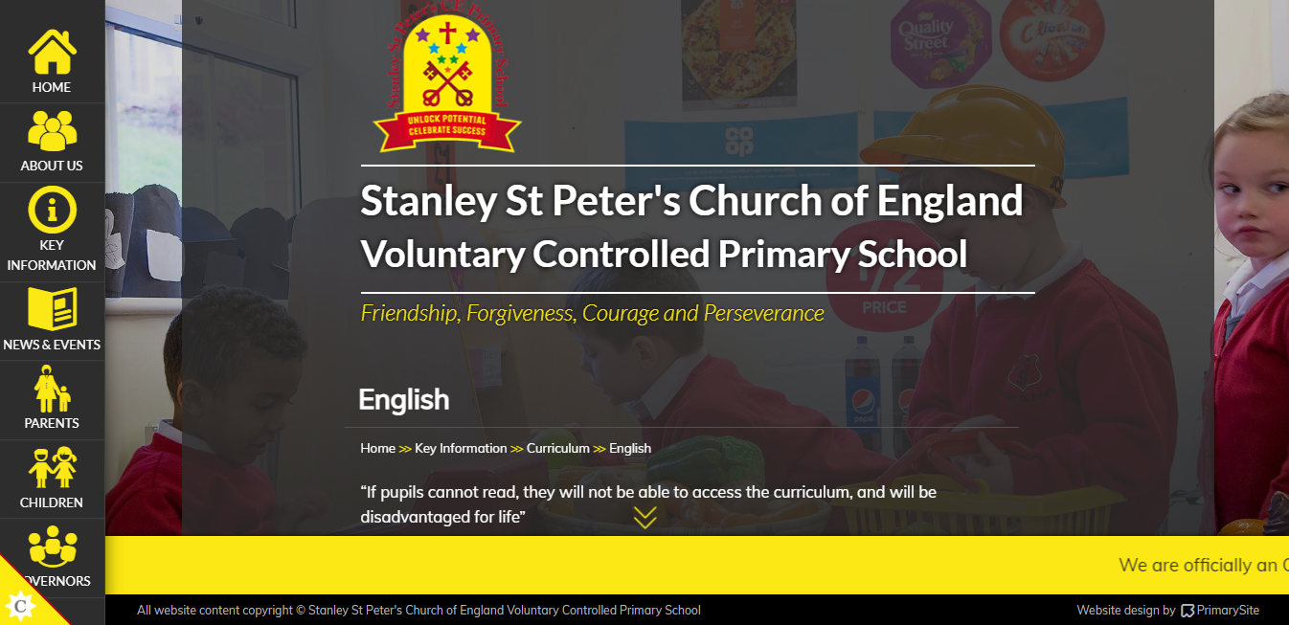
https://www.stanleystpeters.co.uk/english/
Friendship, Forgiveness, Courage, Perseverance, Honesty and Acceptance

Slide 36
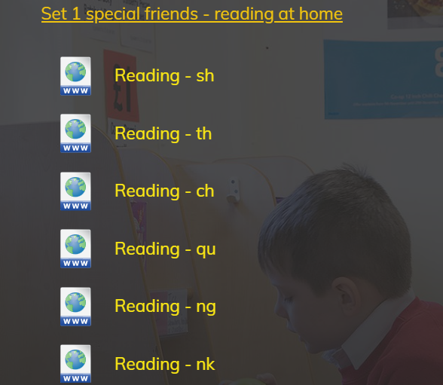
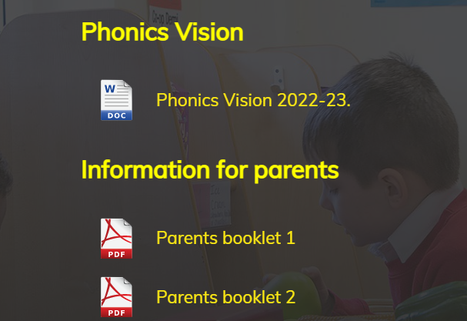
https://www.stanleystpeters.co.uk/english/
Friendship, Forgiveness, Courage, Perseverance, Honesty and Acceptance

Slide 37
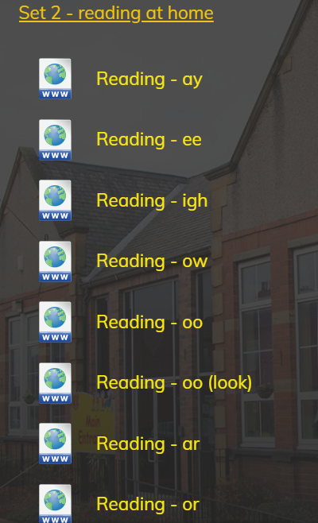
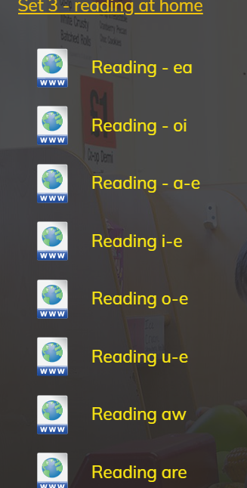
https://www.stanleystpeters.co.uk/english/
Friendship, Forgiveness, Courage, Perseverance, Honesty and Acceptance

Slide 38
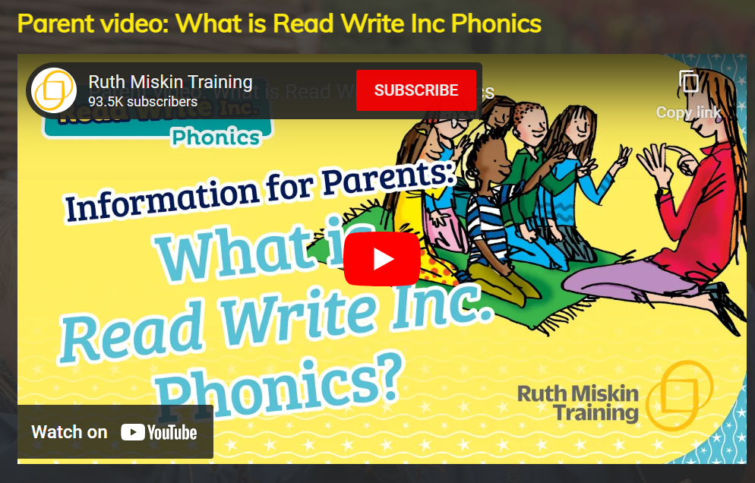
Friendship, Forgiveness, Courage, Perseverance, Honesty and Acceptance

Slide 39
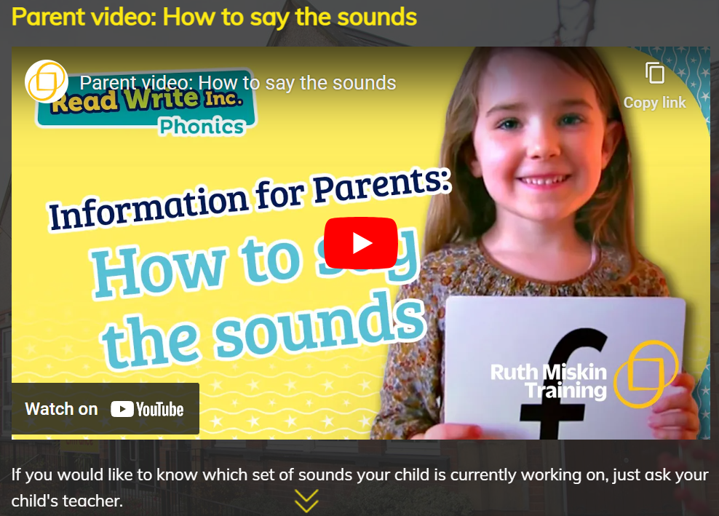

Friendship, Forgiveness, Courage, Perseverance, Honesty and Acceptance

Slide 40

Thank you for listening! Any questions?
Friendship, Forgiveness, Courage, Perseverance, Honesty and Acceptance

