Slide 1


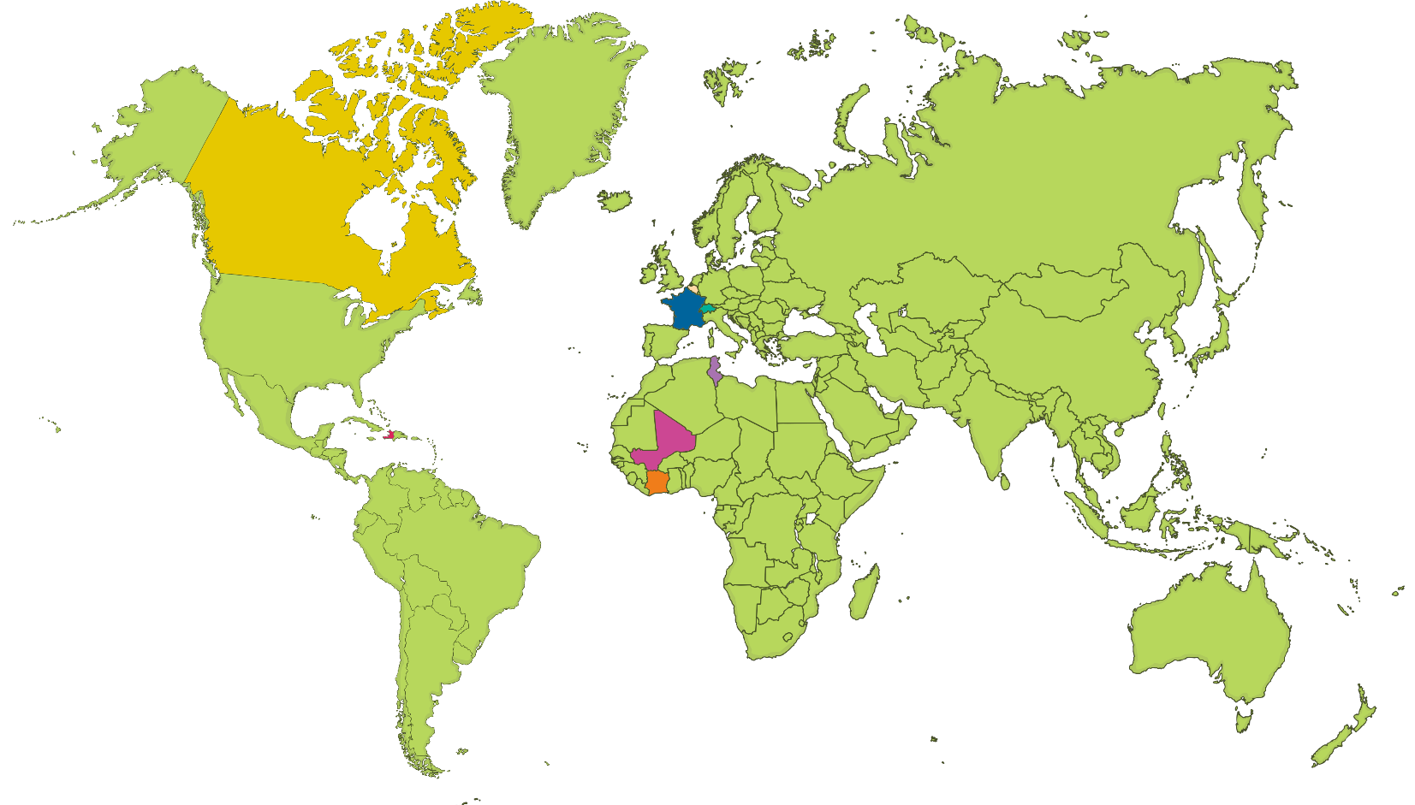
Countries that Speak French
Click play buttons throughout to hear phrases and words.
There are many countries other than France where French is spoken. In all there are over 29 countries where French is an official language. Here are some of them….
France
France
Canada
Canada
Belgium
Belgique
Switzerland
Suisse
Tunisia
Tunisie
Haïti
Haiti
Côte d’Ivoire
Ivory Coast
Mali
Mali

